Slide 1
Task 5
6/16/2023

Slide 2
Pose evaluation
Visual clustering
Audio Process & clustering

Slide 3
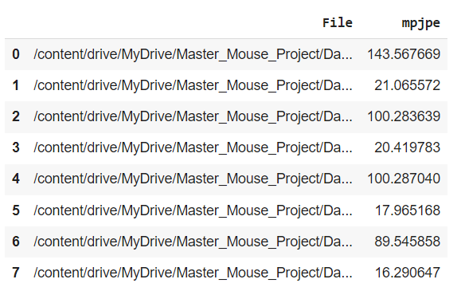
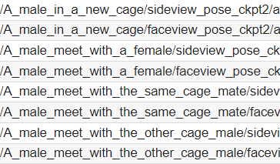
1. Pose evaluation
Updated
pose_evaluation.ipynb
mpjpe_evaluation.json
Problems:
Sideview metrics are very high
pred_visualization.ipynb

Slide 4
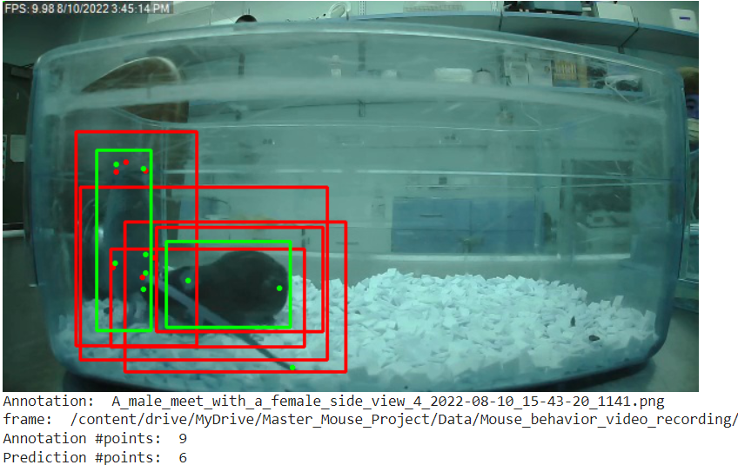
GT Annotation
Prediction

Slide 5
Visualization Conclusions
Conclusions
only detects points for one mouse
#annotation_points != #pred_points
inaccurate #boundingboxes
bounding boxes detect both mice

Slide 6
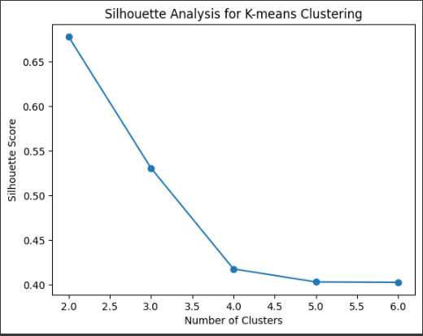
2. Visual clustering
Silhouette analysis: 2 clusters
Problems:
Need to know more about the clustering
Do the files (side, top, face) correspond to the same video?
Could join in one file?

Slide 7
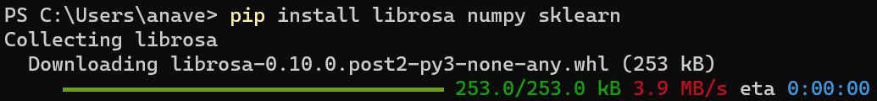
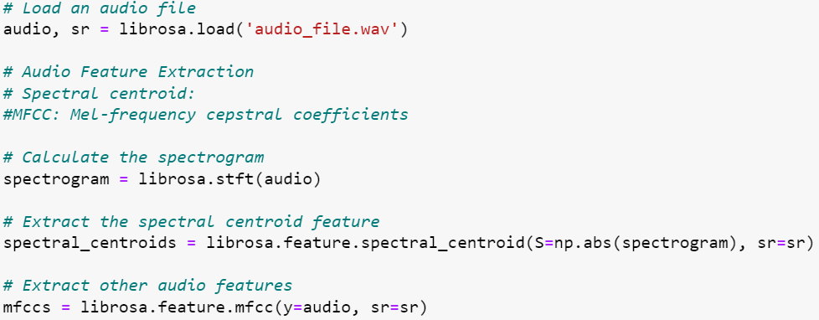
3. Audio Process & clustering
1. Installing librosa
2. Load and process audio files
FEATURE EXTRACTION
•Spectral centroid: center of gravity of the frequency content → average frequency
•MFCC: spectral shape of audio signal → spectral characteristics

Slide 8
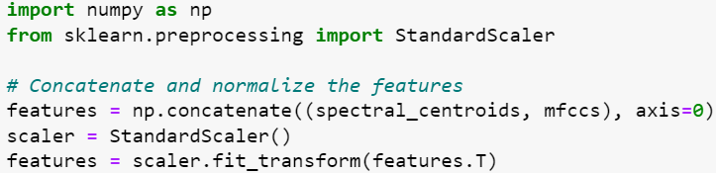
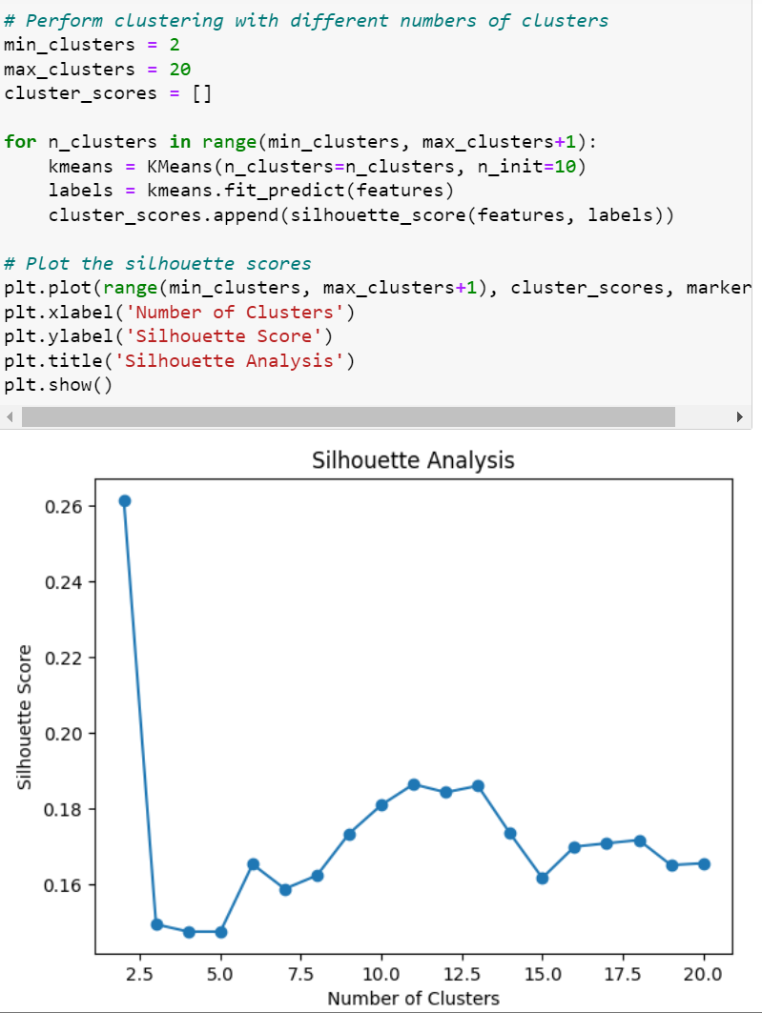
3. Audio Process & clustering
3. Preprocess audio features: concatenate and normalization
4. Apply clustering
•Number of clusters à 2 silhouette analysis

Slide 9
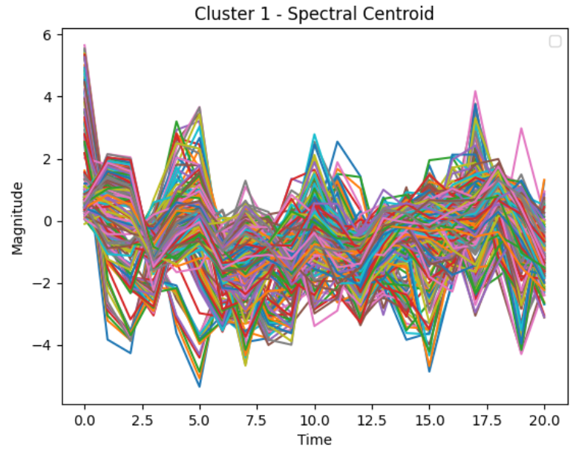
3. Audio Process & clustering
5. Analyze clustering results
6. Next steps:input the real audio files, add more audio features

